Slide 1
TECH TERMS GLOSSARY http://www.techterms.com/
Candayce Smith
Mr. Ojalvo
11-9-13

Slide 2
TECH TERM: VOD
TECH TERM CATEGORY:
Internet Terms
DESCRIPTION:
Any video that can be played at the request of the user
ACRONYM
Video on Demand
PICTURE/OBJECT GALLERY:

Slide 3
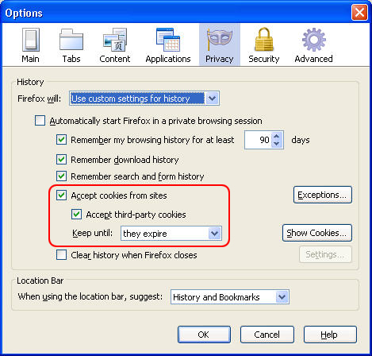
TECH TERM: Cookies
TECH TERM CATEGORY:
Internet Terms
DESCRIPTION:
Small amount of data generated by a website and saved by your web browser.
PICTURE/OBJECT GALLERY:

Slide 4
TECH TERM: (ONE SLIDE FOR EACH TECH TERM)
TECH TERM CATEGORY:
DESCRIPTION:
ACRONYM
PICTURE/OBJECT GALLERY:

Slide 5
TECH TERM: (ONE SLIDE FOR EACH TECH TERM)
TECH TERM CATEGORY:
DESCRIPTION:
ACRONYM
PICTURE/OBJECT GALLERY:

Slide 6
TECH TERM: (ONE SLIDE FOR EACH TECH TERM)
TECH TERM CATEGORY:
DESCRIPTION:
ACRONYM
PICTURE/OBJECT GALLERY:

Slide 7
TECH TERM: (ONE SLIDE FOR EACH TECH TERM)
TECH TERM CATEGORY:
DESCRIPTION:
ACRONYM
PICTURE/OBJECT GALLERY:

Slide 8
TECH TERMS SUMMARY
VOD
COOKIES
ENTER TERM AND INSERT HYPERLINK
ENTER TERM AND INSERT HYPERLINK
ENTER TERM AND INSERT HYPERLINK
ENTER TERM AND INSERT HYPERLINK

