Slide 1
TECH TERMS GLOSSARY http://www.techterms.com/
Candayce Smith
Mr.Ojalvo
11-2-13

Slide 2
TECH TERM: FTP
TECH TERM CATEGORY:
Internet Terms
DESCRIPTION:
Common method of transferring files via the internet from one computer to another
ACRONYM: File Transfer Protocol
PICTURE/OBJECT GALLERY:

Slide 3
TECH TERM: Broadband
TECH TERM CATEGORY:
Internet Terms
DESCRIPTION:
High speed data transmission in which a single cable can carry a large amount.
PICTURE/OBJECT GALLERY:

Slide 4
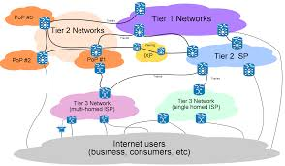
TECH TERM: ISP
TECH TERM CATEGORY:
Internet Terms
DESCRIPTION:
The company that provides internet access to others.
ACRONYM: Internet Service Provider
PICTURE/OBJECT GALLERY:

Slide 5
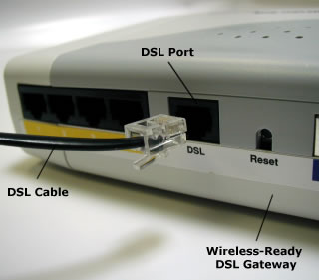
TECH TERM: DSL
TECH TERM CATEGORY:
Hardware Terms
DESCRIPTION:
Transferring data over regular phone lines and can be used to connect to the internet.
ACRONYM: Digital Subscriber Line
PICTURE/OBJECT GALLERY:

Slide 6
TECH TERM: www
TECH TERM CATEGORY:
Internet Terms
DESCRIPTION:
A subset of the internet
ACRONYM
World Wide Web
PICTURE/OBJECT GALLERY:

Slide 7
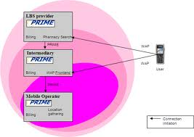
TECH TERM: ASP
TECH TERM CATEGORY:
Internet Terms
DESCRIPTION:
A company or organization that provides software applications to customers over the internet
ACRONYM
Application Service Provider
PICTURE/OBJECT GALLERY:

Slide 8
TECH TERMS SUMMARY
FTP
Broadband
ISP
DSL
www
ASP

